Slide 1

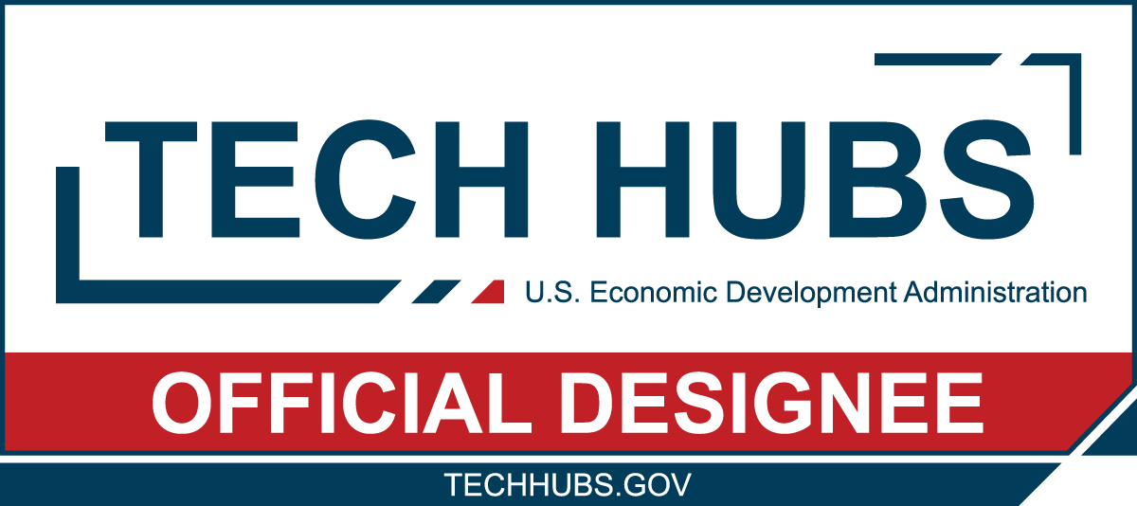
The Growth of EV’s Domestically in the U.S. and Globally and Nevada’s Projected Role in Further Developing U.S. Global Dominance in this Emerging Industry Sector
Dr. Frederick Steinmann
Director, University Center for Economic Development
Principal Investigator, Nevada Regional Technology and Innovation Hub
The Nevada Transportation Conference
Wednesday, May 14, 2025

Slide 2
Nevada’s Regional Technology and Innovation Hub (Tech Hub)
Established on October 23, 2023 as part of the US Economic Development’s Regional Technology and Innovation Hub Program (Phase 1 Designation).
  Includes 16 of Nevada’s 17 counties, 7 of Nevada’s 8 Regional Development Authorities, and both of Nevada’s two Economic Development Districts.
  Over 85 consortium partners: Institutional Partners, Industry, Economic Development Organizations, Workforce Development, State and Local Government, Tribal Governments, Venture Development Organizations
  Key Technology Focus Area: Advanced Energy and Industrial Efficiency Technologies (Critical Elements Tech Hub).
  “Cradle to Cradle” Approach: Extraction to Processing to Manufacturing to Recycling.
July 2, 2024: Announced Funding of $21.5 million for Phase 2 Implementation. Plus $8.5 million in University/State/Other Match.

Slide 3
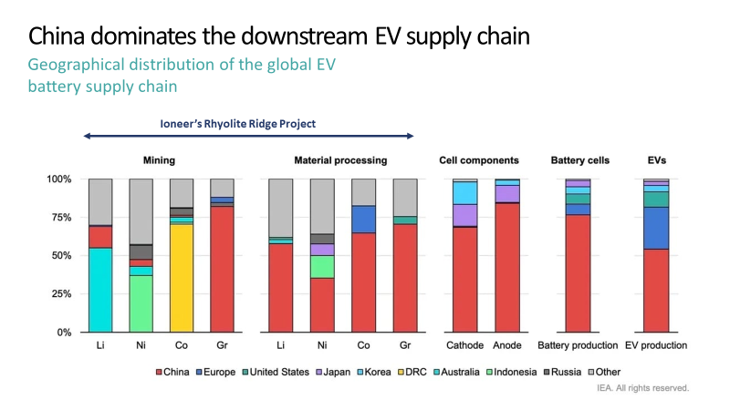
China’s Growing Competitive Dominance in the Lithium Battery, Critical Elements, and Other Electric Vehicle (EV) Materials Sector
“China is not only primed to make hundreds of billions of dollars in revenue, but it is also positioned to restrict access to lithium-ion batteries to certain countries or companies as it wishes. This puts the national security of the United States and its allies at risk. In the event of a war or sudden need to supply an ally or strategic partner with military aid, the United States could face severe shortages of key defense products, such as drones, F-35 fighter jets, surface-to-air missiles, and even radios.”
- New Atlanticist, January 23, 2024

Slide 4
Climate Change Mitigation – the Role of Electrification
“Climate change is happening. Global average temperate has increased about 1.8°F from 1901 to 2016. Changes of one or two degrees in the average temperature of the planet can cause potentially dangerous shifts in climate and weather…many places have experienced changes in rainfall, resulting in more floods, droughts, or intense rain, as well as more frequent and severe heat waves.
The planet's oceans and glaciers have also experienced changes – oceans are warming and becoming more acidic, ice caps are melting, and sea level is rising. As these and other changes become more pronounced in the coming decades, they will likely present challenges to our society and our environment.”
Costs of Climate Change – Billion-Dollar Climate Events in the U.S. in 2023
Drought: 1 event, $14.5 billion cost, 247 deaths
Flooding: 4 events, $9.2 billion cost, 37 deaths
Severe Storm: 19 events, $54.2 billion cost, 100 deaths
Tropical Cyclone: 2 events, $7.8 billion cost, 7 deaths
Wildfire: 1 event, $5.6 billion cost, 100 deaths
Winter Storm: 1 event, $1.8 billion cost, 1 death
TOTAL ALL DISASTERS: 28 events, $93.1 billion cost, 492 deaths
Source: U.S. Environmental Protection Agency; National Centers for Environmental Information

Slide 5
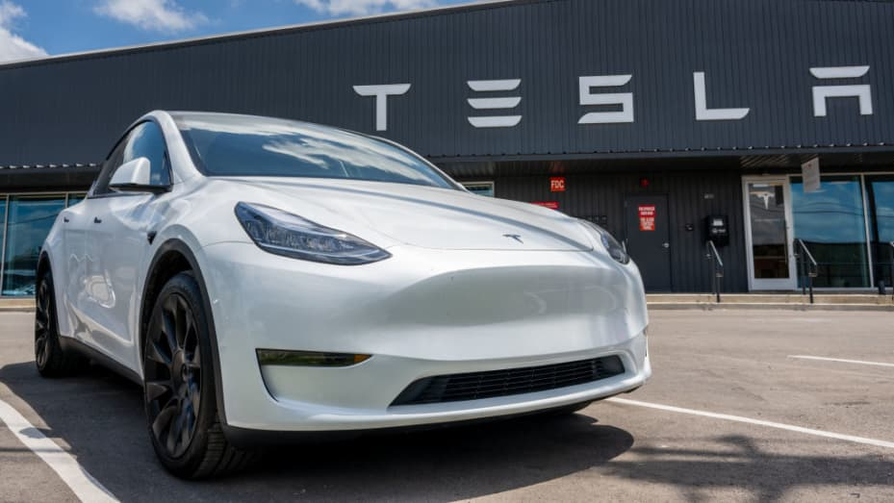
Economic Diversification and Growth – The 21st Century will be Electrified
10 million global new electric vehicle sales in 2022, net increase of 9.0 percent from 2021 and up 5.0 percent from 2020.
Emerging new electric vehicle sales: India, Thailand, and Indonesia where sales of new electric vehicles in these countries more than tripled between 2021 and 2022, reaching over 80,000 total units.
        India: electric vehicle component manufacturing is ramping up, supported by national government investment reaching USD $3.2 billion in 2022 and net private investment in India in electric vehicle component manufacturing reaching USD $8.3 billion in 2022.
Global spending on electric vehicles exceeded USD $425.0 billion in 2022, a net increase of 50.0 percent from 2021.
Global venture capital investments in electric vehicle and battery technologies reached USD $2.1 billion in 2022, a net increase of 30.0 percent from 2021.
Sources: Global EV Outlook 2023 IEA; U.S. Federal Reserve Bank of Chicago; 2023 ERM Group Company

Slide 6
Nevada’s Regional Technology and Innovation Hub (Tech Hub)
Component Projects:
Supply Chain Enhancement
Workforce Development
Lithium Campus
Commercialization and Entrepreneurship
Infrastructure, Community Capacity, and Housing
Nevada Native Nations Center
Governance

Slide 7
Nevada’s Regional Technology and Innovation Hub (Tech Hub)
Workforce Development and the Nevada Nations Center
Workforce Development
Project Coordinator : Nevada Office of Workforce Innovation
Proposed Budget: $17,893,777
Key Considerations: Industry and Organized Labor Driven
Specific Initiatives: Assistance in Meeting Workforce Needs; Ensure Personnel Access to Professional Development; Facilitating Career Education in High Schools & Adult Basic Education and ESL Programs
The Nevada Native Nations Center
Project Coordinator : University of Nevada, Reno Office of Indigenous Relations
Proposed Budget: $3,989,526
Key Considerations: Industry Driven, EDA Driven, Address Diversity, Equity, Inclusion
Specific Initiatives: Nevada Native American Youth LEAD Program; Nevada Tribal Academy; Nevada Tribal Leadership Development Program; Tribal Government/Governance Workshops; Enhanced Tribal Consultation

Slide 8


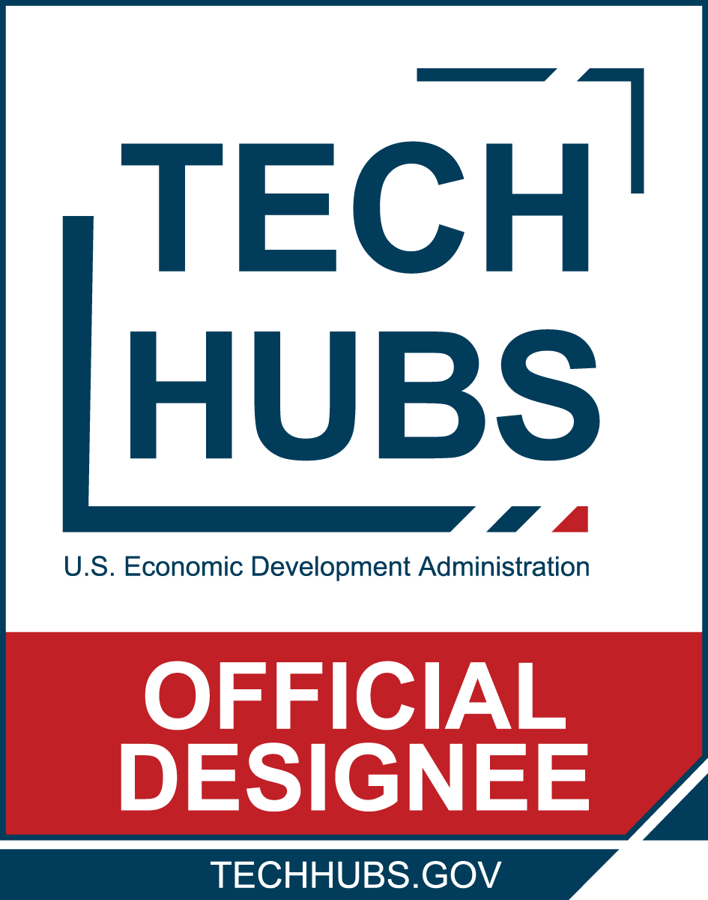






Community and Economic Development Efforts: Supply Chain Enhancement, Commercialization and Entrepreneurship, and Infrastructure, Community Capacity, and Housing

Slide 9
The University of Nevada, Reno
The University of Nevada, Reno is ideally suited to lead the Nevada Tech Hub and the Component Projects:
  Nevada’s Land Grant Institution, 150 Year Anniversary: the Nevada Tech Hub aligns with the University’s Mission (13 Colleges including the College of Business, College of Engineering, College of Agriculture, Biotechnology, and Natural Resources, College of Education, School of Medicine, College of Science)
  Long-standing relationship with Mining, Materials Extraction, and Processing.
  32-Year Relationship between EDA and the University Center for Economic Development.
  Existing NSF Engines Type 1; Applying for NSF Engines Type 2
  Committed to Innovation and Entrepreneurship across Multiple Programs and Centers.
  Provided Financial and Non-Financial Support for Tech Hub Phase 1 and Phase 2 application process.
  Institution-Wide Support; University of Nevada, Reno President Brian Sandoval is a former Governor, former Federal Judge, and University of Nevada, Reno Graduate.

Slide 10
The Growth of EV’s Domestically in the U.S. and Globally and Nevada’s Projected Role in Further Developing U.S. Global Dominance in this Emerging Industry Sector
Thank You.
Dr. Frederick Steinmann
Director, University Center for Economic Development
Principal Investigator, Nevada Regional Technology and Innovation Hub
fred@unr.edu
The Nevada Transportation Conference
Wednesday, May 14, 2025

